Slide 1
How Can We Heal Money Wounds?
Clergy Respond to Fiscal Trauma
Vanessa Jackson, LCSW
Healing Circles, Inc.
Atlanta, Georgia
www.healingcircles.org

Slide 2
Workshop Intentions
To assist participants in identifying fiscal trauma and how it influences their relationship with money and prosperity
To assist participants in identifying what prosperity and abundance means to them and ways to achieve it at all income levels.
To enhance participants’ ability to talk openly and honestly about their relationship with money and to guide their congregations in soulful conversations about money.

Slide 3
Shared Understandings
Honest conversations about money require a “Safe Enough” environment. We all share responsibility for making this space a place where people can speak honestly without fear of judgments.
We each agree to maintain confidentiality about stories shared in the workshop. We respect the right of every person to share his/her story with the person of their choosing when they are ready. We agree not to put folks’ business in the streets.
We will share the time. If I am a talker, I will make sure to create space for more quiet members to share their thoughts and feelings. If I tend to be quiet, I will stretch myself and talk since I may have knowledge and inspiration which can transform someone’s life.
I cannot heal what I conceal. I will practice vulnerability.
This is a “to be continued” experience. I will get the most benefit from the workshop if I commit to taking the information back into my day-to-day life with family and friends and refine my prosperity vision.

Slide 4
Take a minute to write down how much money you make annually. Now look at that number and notice how it makes you feel.
What would it feel like if I asked you to share that number with your closest friend? If you posted it in the chat?

Slide 5
Values and Vision
1)What was your earliest or most important message (verbal or non-verbal) from your family about money?
2)How does that message influence your money attitudes and behavior today?
3)What attitudes or behaviors have allowed you to achieve some degree of success in opening yourself up to prosperity? How are you able to calm “ Money Panic” when s/he rolls up next to you?
4)What is one fear that you would have to release to invite more prosperity into your life?
5)What is one action that you are willing to take within the next week to invite prosperity into your life?
6)What are two things that members of the Prosperity Circle can offer you to support you in taking the next step into prosperity?

Slide 6
What is Fiscal Trauma
Fiscal trauma is the emotional and spiritual consequences of not having adequate financial resources to live your life in your preferred manner with the assurance that you can meet your financial obligations. It can occur at all income levels. When fiscal trauma is explored in clinical settings, individuals often report feelings of anxiety and panic, depression, despair, hopelessness, fear, anger, rage, a sense of worthlessness and low self-esteem. These feeling can often persist after economic stabilization has been achieved. Healing conversations should explore what impact the perception and/or experience of economic lack has on an individual’s sense of self, their relationships with family and friends, their views about economic and career possibilities and their relationship with their community.
Healing conversations must include a discussion of external factors (social, economic, political, geographical) that impact the individual’s access to necessary resources.

Slide 7
And if we look closely enough, we’ll have to conclude that poverty is not, after all, a cultural aberration or a character flaw. Poverty is a shortage of money.
Barbara Ehrenreich

Slide 8
Brainstorm
What are some ways that fiscal trauma is created and maintained in your life?

Slide 9
Small Group Discussion
What are the ways that fiscal trauma impact your ability to perform your role as spiritual leader?
As a spiritual leader, what strategies have you found useful to release the struggle with fiscal trauma?

Slide 10
Healing Fiscal Trauma
Name
Analyze
Strategize
Act

Slide 11
Nurturing Resiliency: Strategies for Change and Healing
Clergy are in a powerful position to invite in conversations about how we reclaim our holy days from consumerism. Example, “having a GOOD Christmas” can seriously undermine a family's finances for the entire year and induce profound shame in parents and children. What if we helped our congregations reclaim the spirit of our holidays? How are you already doing this in big and small ways?
Create safe and validating spaces to talk about how you have been affected by financial downturns or life long experiences of insufficient financial resources
Acknowledge and address your own financial trauma. Speak honestly about how you have been affected by your relationship with money.

Slide 12
Look for opportunities to collaborate with others (buying in bulk, home exchanges, gig economy, selling items that you do not need)
Invite your family into the conversation about how to have more joy without purchasing more stuff?
Use the economic squeeze as an opportunity to re-evaluate what you need, why you need it and are you still enjoying it in your life?
Do not allow embarrassment or shame to keep you silent or immobilized!

Slide 13
Sacred Enoughness
What is your Enough point in terms of income and resources?
How did you come to that figure?
What does it afford you?

Slide 14
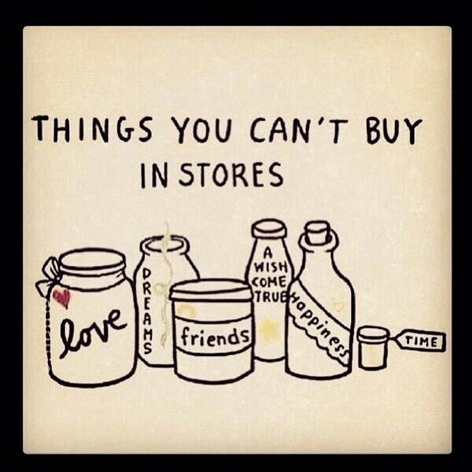

Slide 15
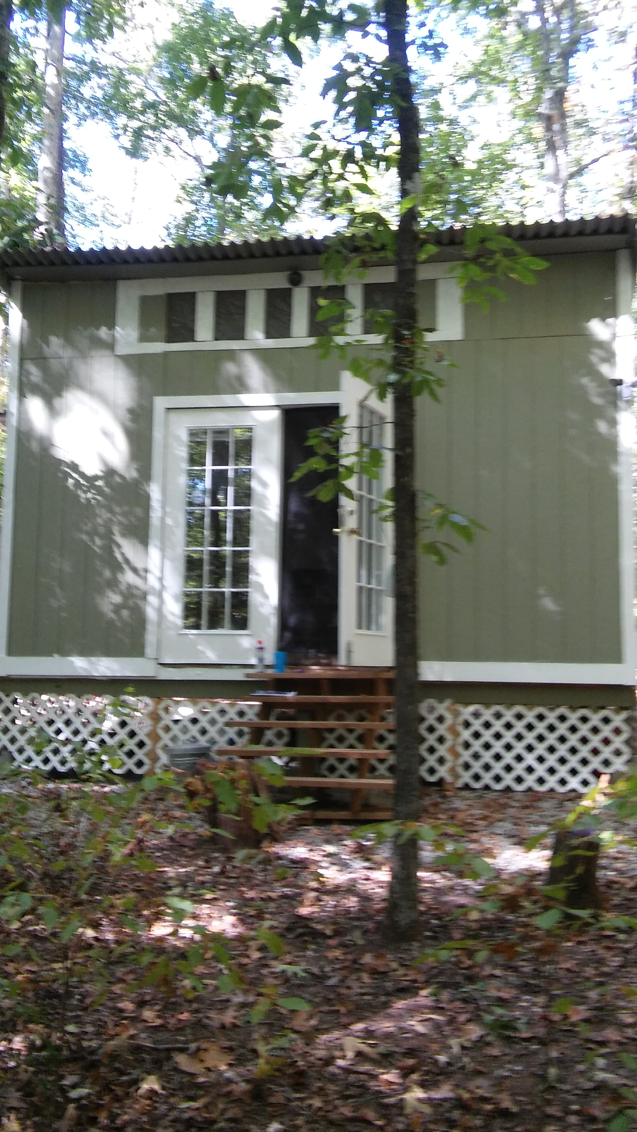


Slide 16
Heart’s Desires
(What do I really need to feel delighted and fulfilled as a person?)
What do I desire ( experience, item, relationship, etc.)?
How would it make me feel to have my Heart’s Desire?
How would having my Heart’s Desire support my spiritual growth?
How would having my Heart’s Desire support my core relationships?

Slide 17
